Slide 1

Evaluation in Government: Introduction to the Evaluation Task Force
Miriam Light
Evaluation Lead
Evaluation Task Force
Notes:
MIRIAM

Slide 2


Evidence generation in UK Government
8%
A 2019 review showed only 8% of spending on government major projects had robust evaluation plans.
£678bn
The Government Major Projects Portfolio now represents £678 billion of government spending, around 40% more than at the time of the 2019 study.
“…the use of evaluation continues to be variable and inconsistent…[so] government cannot have confidence its spending in many policy areas is making a difference”
Notes:
Why evaluation and use of evidence are important
Government spends about 1.1 trillion/year to deliver for the public. This is largely funded by tax payers and we have a duty to ensure that each pound spent is delivering maximum impact.
A review by the PMIU in 2019 identified that only 8% of spend of GMPPs are robustly evaluated. That means for more than 400b pounds of spending we do not know whether the activity is funding is effective or, might be even causing harm.
That is £13,000 being spent for every household in the UK without properly knowing whether it’s doing any good
A 2021 review by NAO evaluating government spend found the use of evaluation was variable and inconsistent. And when the ETF was set up only 6 of the major 16 dep had an evaluation strategy in place to outline how they’d ensure evaluation would be integrated and evidence used to inform policy decisions.

Slide 3

What is the Evaluation Task Force?
The ETF is a joint unit with Cabinet Office and HM Treasury, reporting to the Director of Public Spending Nick Donlevy.
Together with HMT we work to ensure that we understand the impact of government interventions, which informs evidence-based decisions about stopping, continuing, expanding or modifying programmes.
We achieve this by working closely with government departments to increase the number and quality of evaluations being undertaken.
Notes:
Which is where we come in!
A joint HM Treasury and Cabinet Office unit, the ETF was set up to put evaluation evidence at the heart of government decisions and ensure we’re taking an evidence-based approach to decision making.
We were set up in April 2021 and are currently around 16 people in total.
Our mission is to ensure robust evidence underlies decisions about how we spend government money - and we are pushing for more and better evaluation across government
We are experimental by default - which means we push for the greater use of experimental evaluations (incluing RCTs) where possible. We recognize there are many factors that will influence decisions about appropriate design for an evaluation - but we are very keen to seen the greater use of RCTs in government and believe there are many opportunities for this (which aren’t always taken).

Slide 4
What is the central mission of the Evaluation Task Force?
The ETF intends to improve people’s lives by ensuring robust evidence on the effectiveness of policies and programmes sits at the heart of spending and operational decisions.
improve the way government programmes are evaluated in order to inform decisions on whether they should be stopped, continued, expanded or modified
support departments to conduct programme evaluations that are both robust and proportionate
empower departmental analysts to play a central role in the design of programmes as well as spending and operational decisions affected by evaluation results
Notes:
The ETF is seeking to apply the methods of evaluation and experimentation that are common in medicine to the £1 trillion that HM Government spends each year on public services.
We would never consider rolling out a vaccine that had not been rigorously tested yet we continuously roll out policies in education, social welfare, and other key areas of public spending without truly understanding if the policy works or having the right systems in place to measure their effectiveness.
The team drives continuous improvements in the way HM Government programmes are evaluated to inform decisions on whether they should be continued, expanded, modified or stopped.
The ETF provides departments with ‘reactive’ evaluation advice and support (in response to department requests), as well as a ‘proactive’ scrutiny and challenge function (which is guided by HMT priorities and key interests across government).
Since its inception, the ETF has advised on over 300 government programmes covering £140bn of spend.

Slide 5
How will we achieve our aims?
HM Treasury
Spending review
Settlement conditions
Departments
Evaluation plans
Access to evaluation specialists
Transparency
Registry of evaluations / trial protocols
Publication of evaluation findings
Culture change
Governance and process changes
Capacity building

Slide 6



Evaluation & Trial Advice Panel (ETAP)
65 PANEL MEMBERS
Wide range of methodological expertise….
EXPERIMENTAL
QUASI-EXPERIMENTAL
THEORY-BASED
ECONOMIC
Take slide from CBE w figures on
23 FROM ACADEMIA
23 FROM RESEARCH INDUSTRY
13 FROM GOVERNMENT
6 FROM WHAT WORKS
CENTRES
Notes:
Experts come from academia, government, research organisations and other areas with an understanding of the policy environment and the realities of undertaking evaluations at pace in complex areas of social policy.
All members have signed an agreement / MoU with us that sets out the principles of their voluntary participation in the panel - this covers things like keeping information shared confidential and alerting us and the department seeking advice to any potential conflicts of interest - talk more about this in a moment.
So what does the panel actually do?
In a nutshell, the Panel aims to provide advice to government departments and What Works Centres on the most robust evaluation designs in order to produce stronger evidence of 'what works' and inform decision making in government. The panel can provide advice at any stage of the evaluation process, but we encourage departments to seek support from the panel as early as possible in the policy design stage so we have the best chance of applying a robust evaluation to it.
This involves a range of activities -
Advice surgeries: The main activity for panel members is advice surgeries. These are roundtable discussions which take place online and usually last 1 - 1.5hours.
Here, we encourage the department seeking support to lead these discussions, starting by presenting their programme /policy to the panel members and providing information on any current evaluation plans.
We do, however, always have a chair from the ETF on hand to support the conversation and someone to take notes.
We have had really good feedback on advice surgeries and find they allow us to go into the details of an evaluation and really consider what the best approach is.
Panel members agree to give up to 2 hours a month for these activities. As we have a large panel we often find they don’t need to give this amount of time. We recognise that panel members have commitments beyond this so we like to ensure the workload is reasonable.
We would encourage you to invite policy colleagues, to feed into design of any future policies
One-to-one advice: Panel members may also be involved in providing one off or short-term advice to specific teams in government who are dealing with a complex methodological issue whereby one panel member may provide advice and guidance.
Reviewing docs: We may also ask panel members to do desk based reviews of evaluation plans, trial protocols and final reports - sometimes acting as the named QA on the report. We understand these requests from departments may go above the expected time commitments we have asked from panel members so in some cases these may be paid opportunities. We manage these types of requests centrally in the ETAP secretariat.
Teach ins and events: Teach ins and events are an opportunity for panel members to share their expertise, network and learn more about government evaluation. These haven’t been a major part of what the panel does in previous years, however we are keen to expand this further if there is the sufficient interest from panel members - we can discuss this in the Q&A further.

Slide 7
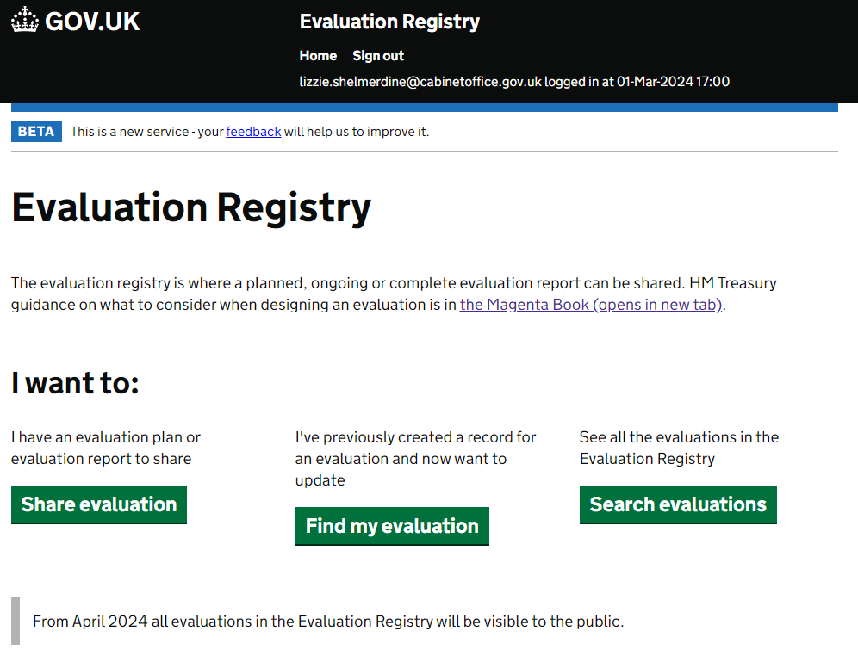
The Evaluation Registry
The Evaluation Registry is the new home for all Government evaluations.
It is a website where all Government evaluations (planned, ongoing or complete) should be registered.
Evaluations entered on the Registry can be searched and browsed by users to learn from previous evaluation findings and plan new research.

Slide 8
ETF Evaluation Academy
Module 1: Introduction to Evaluation
Module 2: Developing a Theory of Change
Module 3: Scoping an Evaluation
Module 4: Process Evaluation
Module 5: Impact Evaluation - Experimental Designs
Module 6: Impact Evaluation - Quasi-Experimental Designs
Module 7: Impact Evaluation - Theory-Based Designs
Module 8: Value for Money Evaluation
Module 9: Planning and Managing an Evaluation
Module 10: Communicating Evidence and Decision Making
The Evaluation Academy upskills analysts across HMG departments in key evaluation methodologies and evaluation management techniques and will result in better and more evaluation across HMG.
Create a common language.
Build a common understanding.
By doing this we will raise the floor, raise awareness, and raise confidence.
We achieve collective efficacy.

Slide 9













What Works Network
Focus on policing & criminal justice
Focus on higher education
Focus on inequalities in ageing.
Focus on financial wellbeing
Focus on education
Focus on preventing youth violence
Focus on youth
employment
Focus on local growth policy
Supports policy decisions in Wales
Focus on children and families
Centre Homelessness Impact
Provides guidance to improve health and social care
Focus on homelessness
Notes:
The ETF is the secretariat for the WWN. The What Works Network was established in 2013 with the aim of improving the way government and other public sector organisations create, share and use high quality evidence in decision-making. The network supports the drive for more effective and efficient services across the public sector at national and local levels. The network is made up of 10 What Works Centres, 3 affiliate members and one associate member. Together these centres cover policy areas which account for more than £250 billion of public spending.
We broker relationships between government (both policy makers and analysts) and WWCs - identyfing opportunities and using our networks to ensure the work of WWCs is both being used to inform decision making and having an impact - and ensuring its well aligned to government priorities.
The ETF is also responsible for coordinating cross-network activity, judging applications from organisations interested in What Works Network membership status, and providing information and guidance to organisations exploring possible membership applications.

Slide 10




What Works Centres
Reviewing evidence
Generating evidence
Review the best evidence available to determine what interventions work
Fund and conduct independent evaluations
Summarising evidence
Putting evidence into action
Produce accessible guidance, toolkits and recommendations
Support and encourage stakeholders to implement effective interventions

Slide 11



Summary: How we are achieving our central missions
Improve the way government programmes are evaluated
Support departments to design robust and proportionate evaluations
Empower departmental evaluators/analysts and decisions affected by evaluation results
WHAT WORKS NETWORK
EVALUATION & TRIALS ADVICE PANEL
THE EVALUATION REGISTRY
THE EVALUATION ACADEMY
Notes:
So to round off my presentation showcasing the fantastic work of the ETF I thought it would be only right to bring it back to how all four of the examples I have walked through are achieving our central missions.

Slide 12
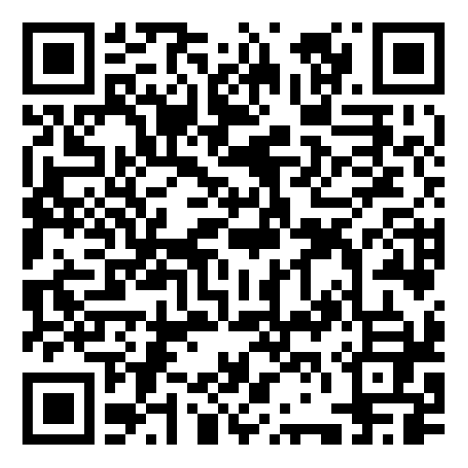
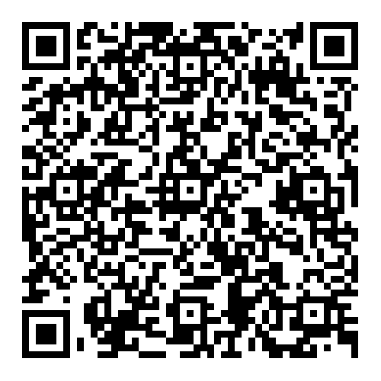
Useful links and resources
Evaluation Task Force (ETF) website
Evaluation Trials Advice Panel (ETAP)

Slide 13
Please get in touch for further information…
etf@cabinetoffice.gov.uk
miriam.light@cabinetoffice.gov.uk

